Slide 1

Federated Generative AI
Dong Yang, Yue Wang
Computer Science
Georgia State University, Atlanta, GA, USA
Apr 4, 2025

Slide 2
Outline
Introduction
Federated GAN
Federated VAE
Federated Diffusion Model
Federated Transformer

Slide 3
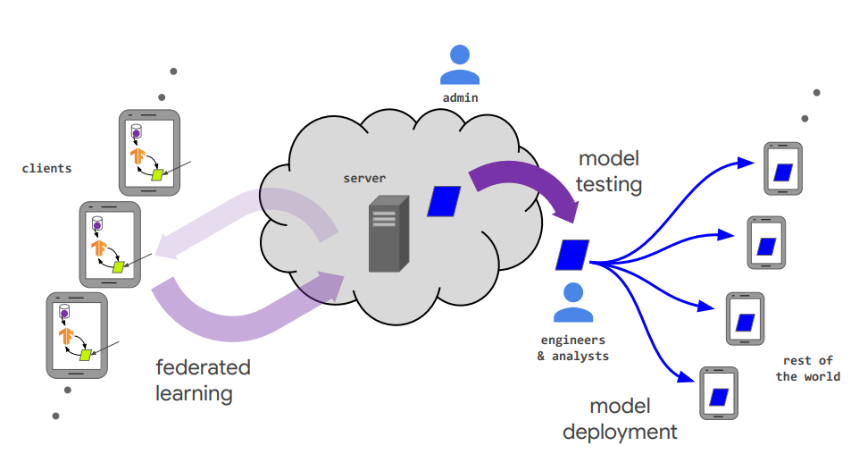
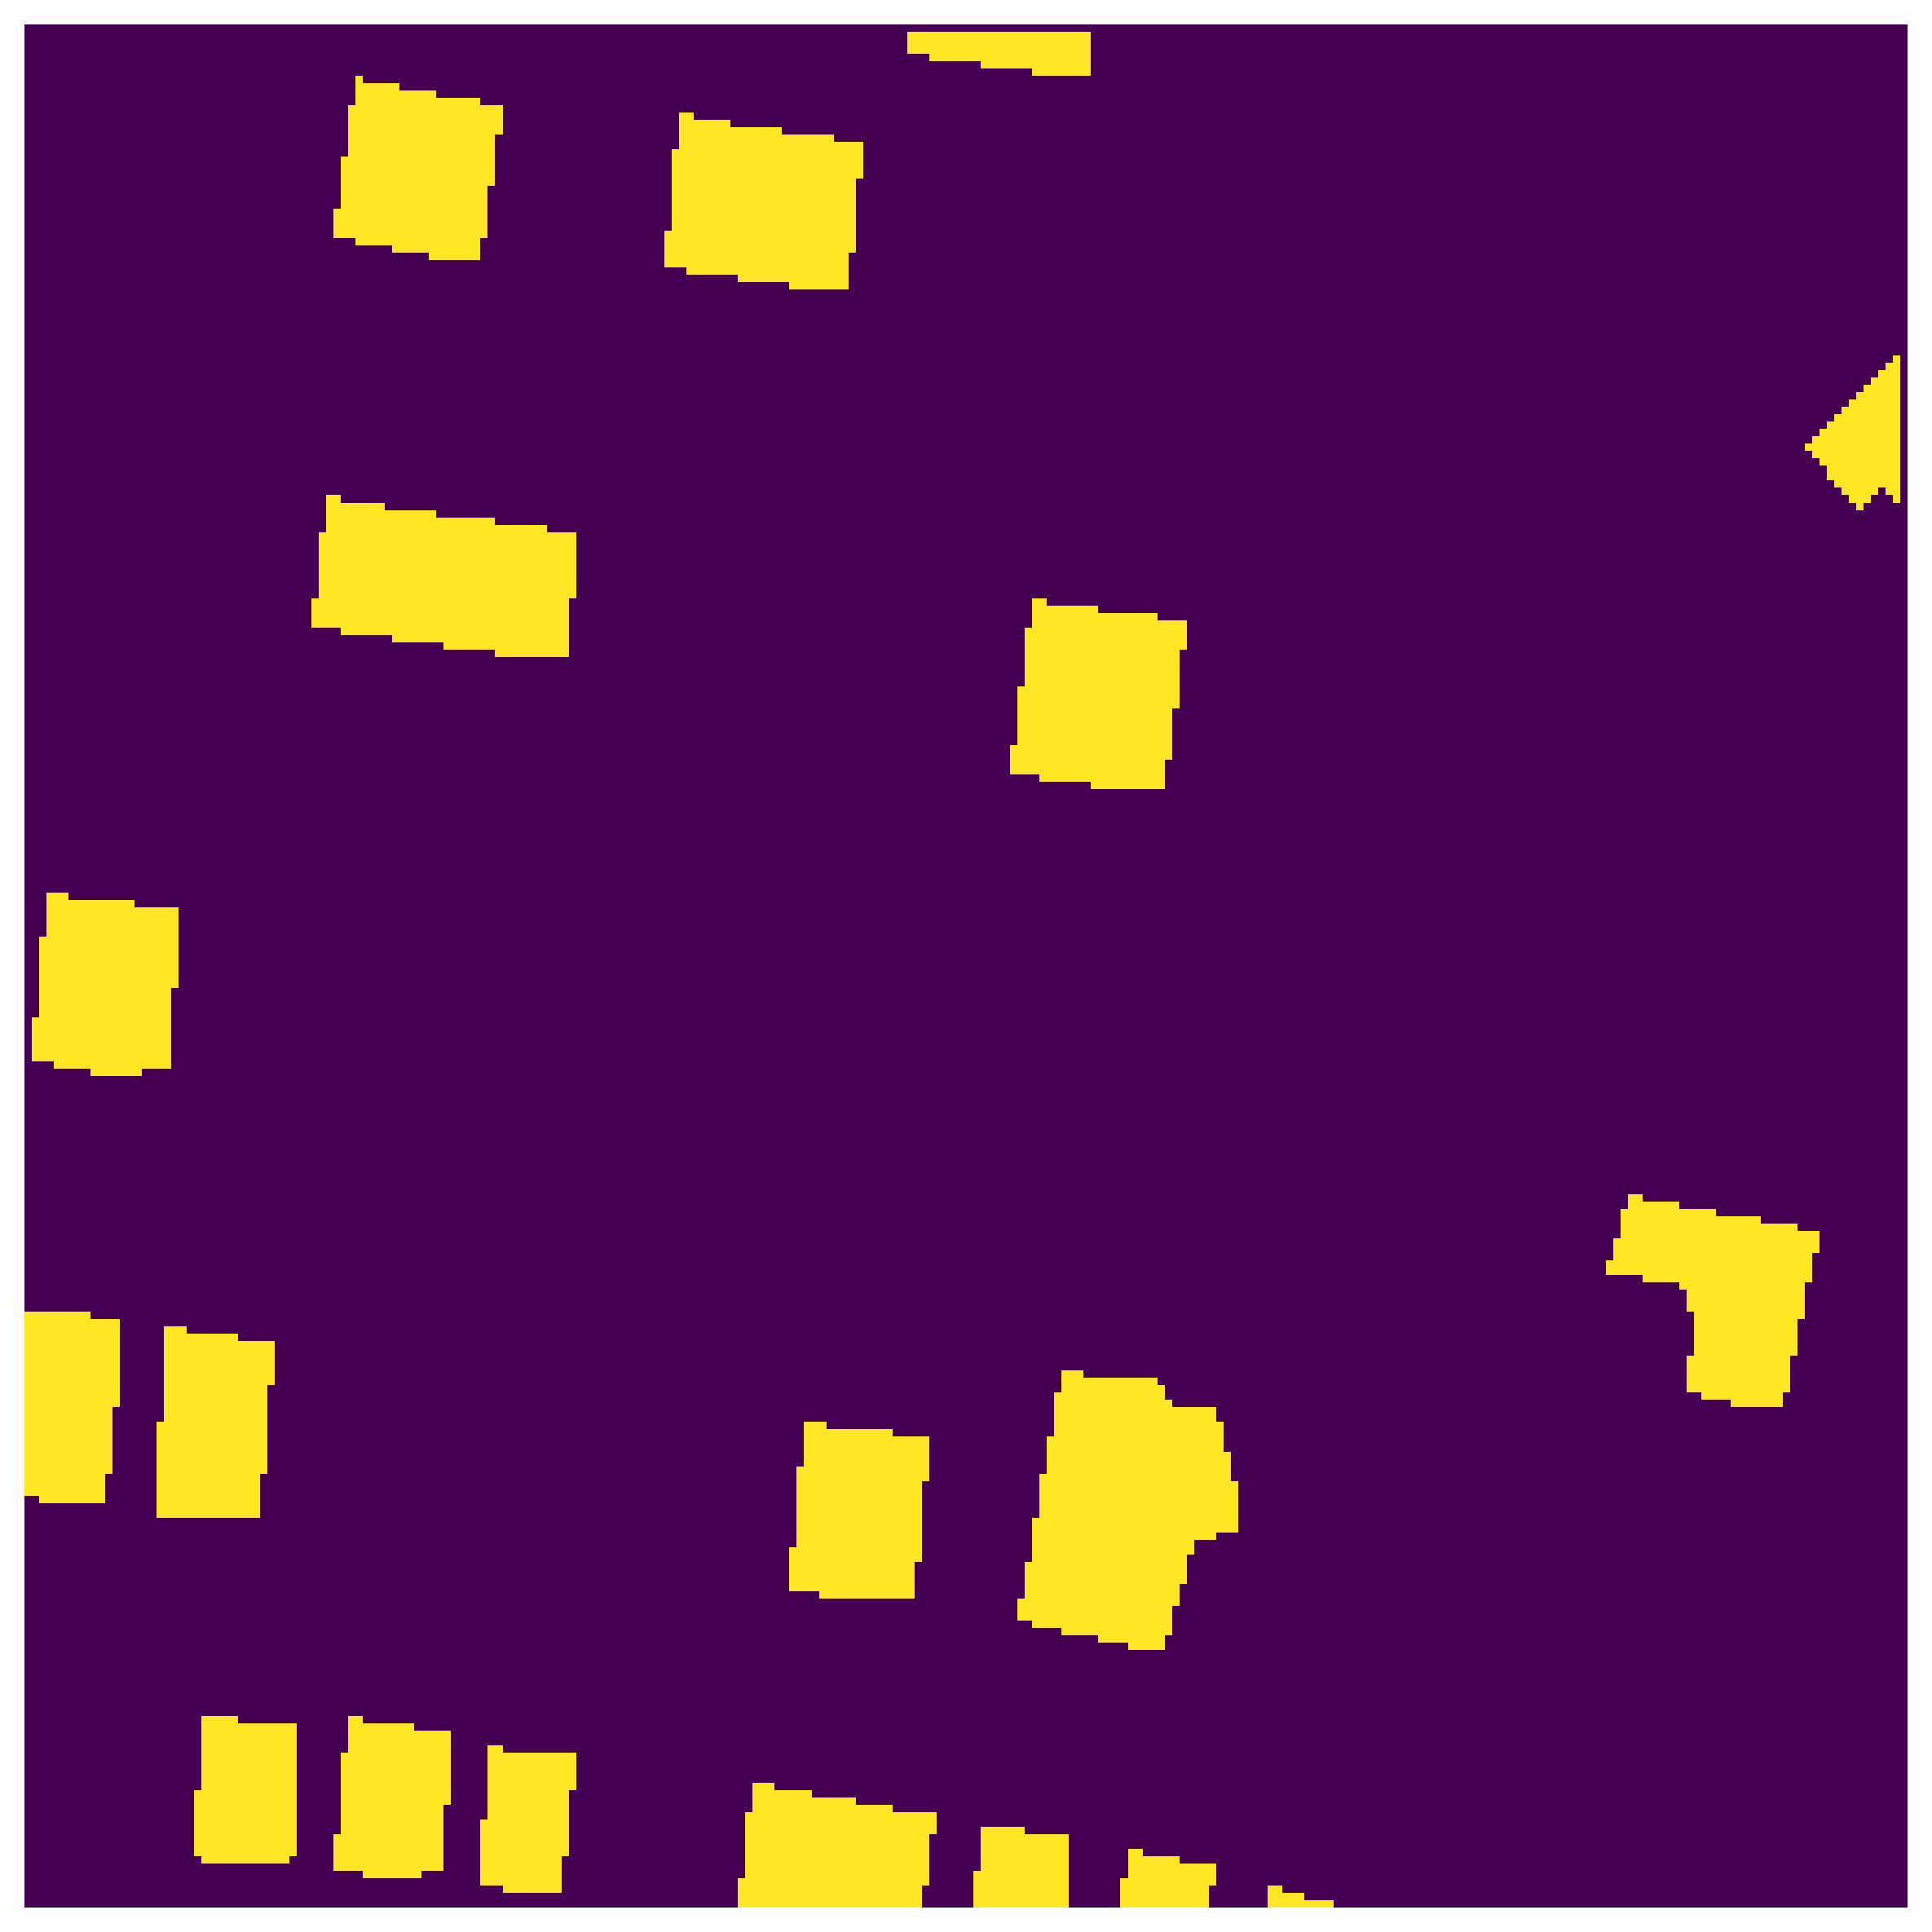
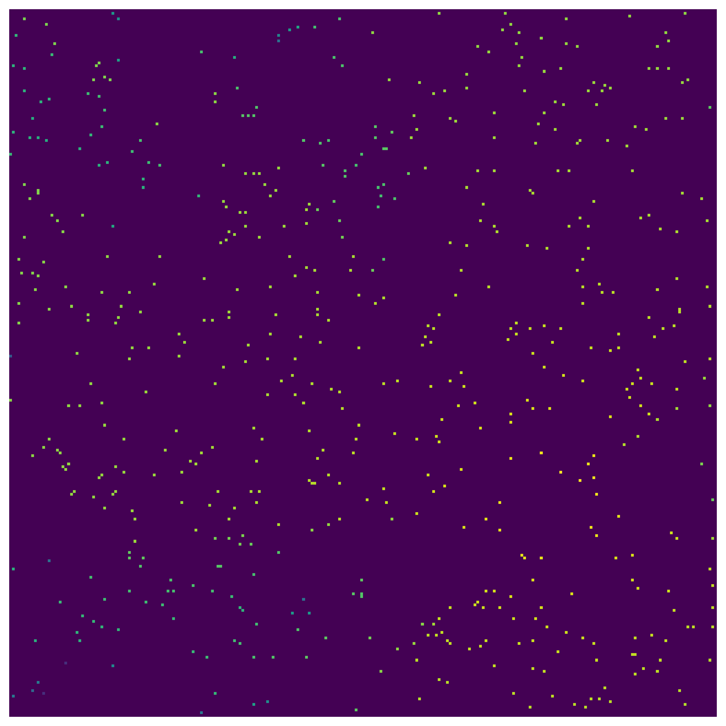

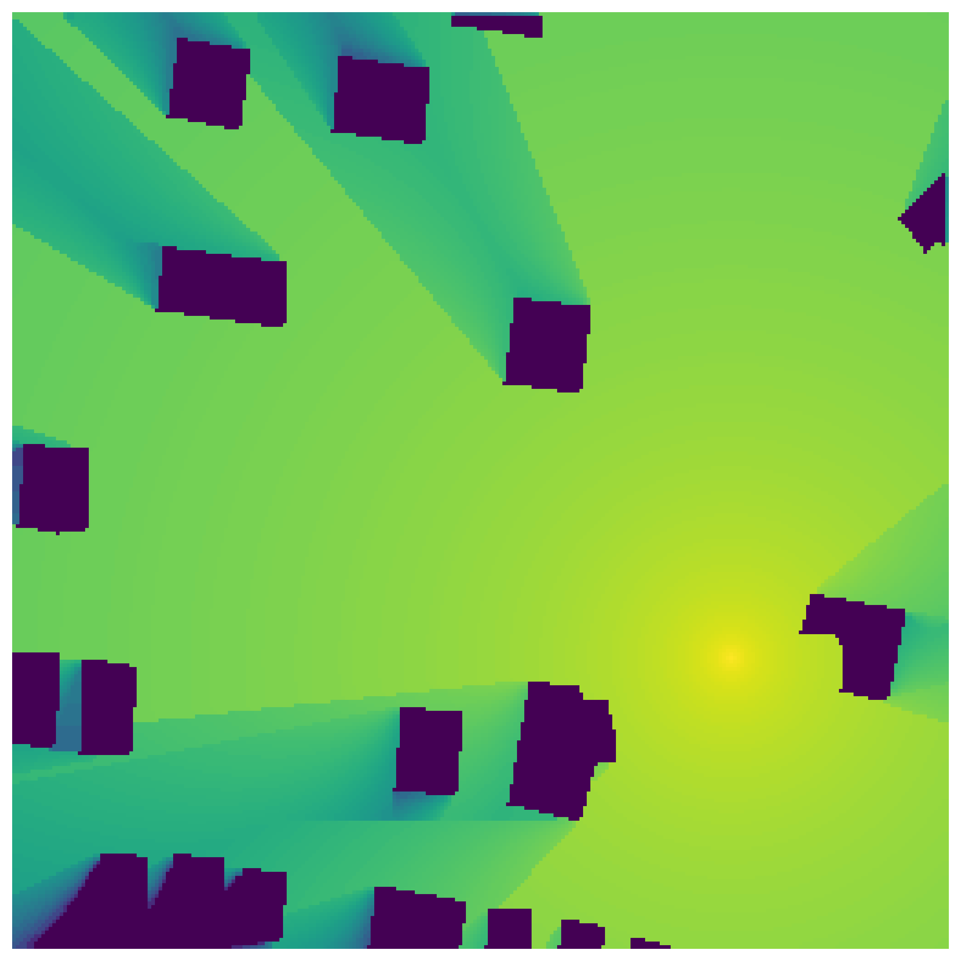
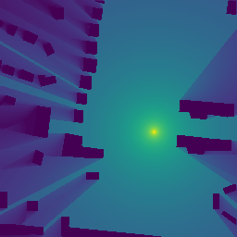

Introduction
Radio map: radio power as a function of location x, frequency 𝑓 and/or with time 𝑡 denoted by
$$Φ \left(x,f,t\right)$$

Slide 4
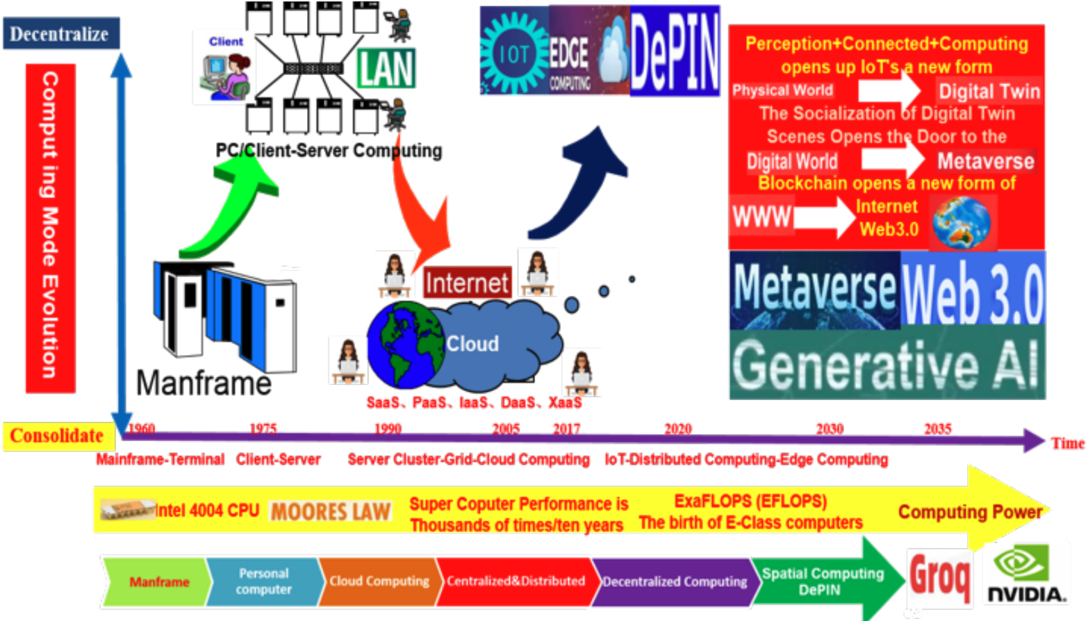

Introduction - The Development of Computing Models
Mainframe
W. Li, Y. Song, and S. Wang, “Intelligent computing, computational power, computational power networks and technology ecosystems,” in 2024 IEEE 14th International Conference on Electronics Information and Emergency Communication (ICEIEC). IEEE, 2024, pp. 1–8

Slide 5
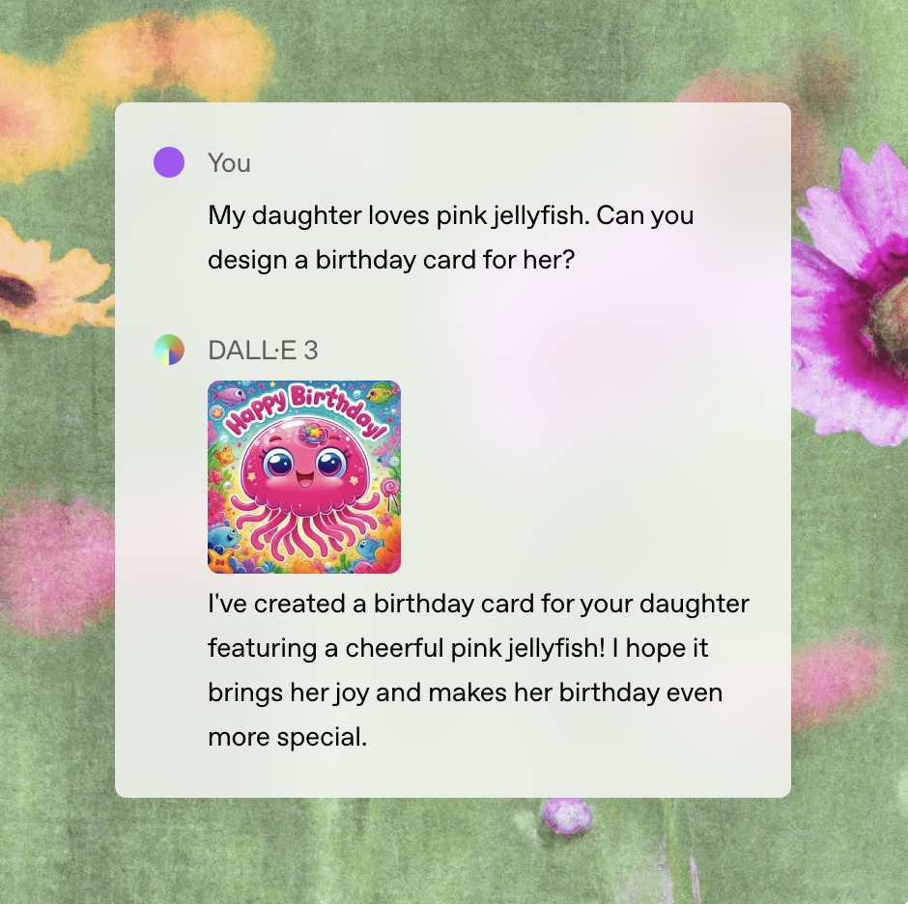
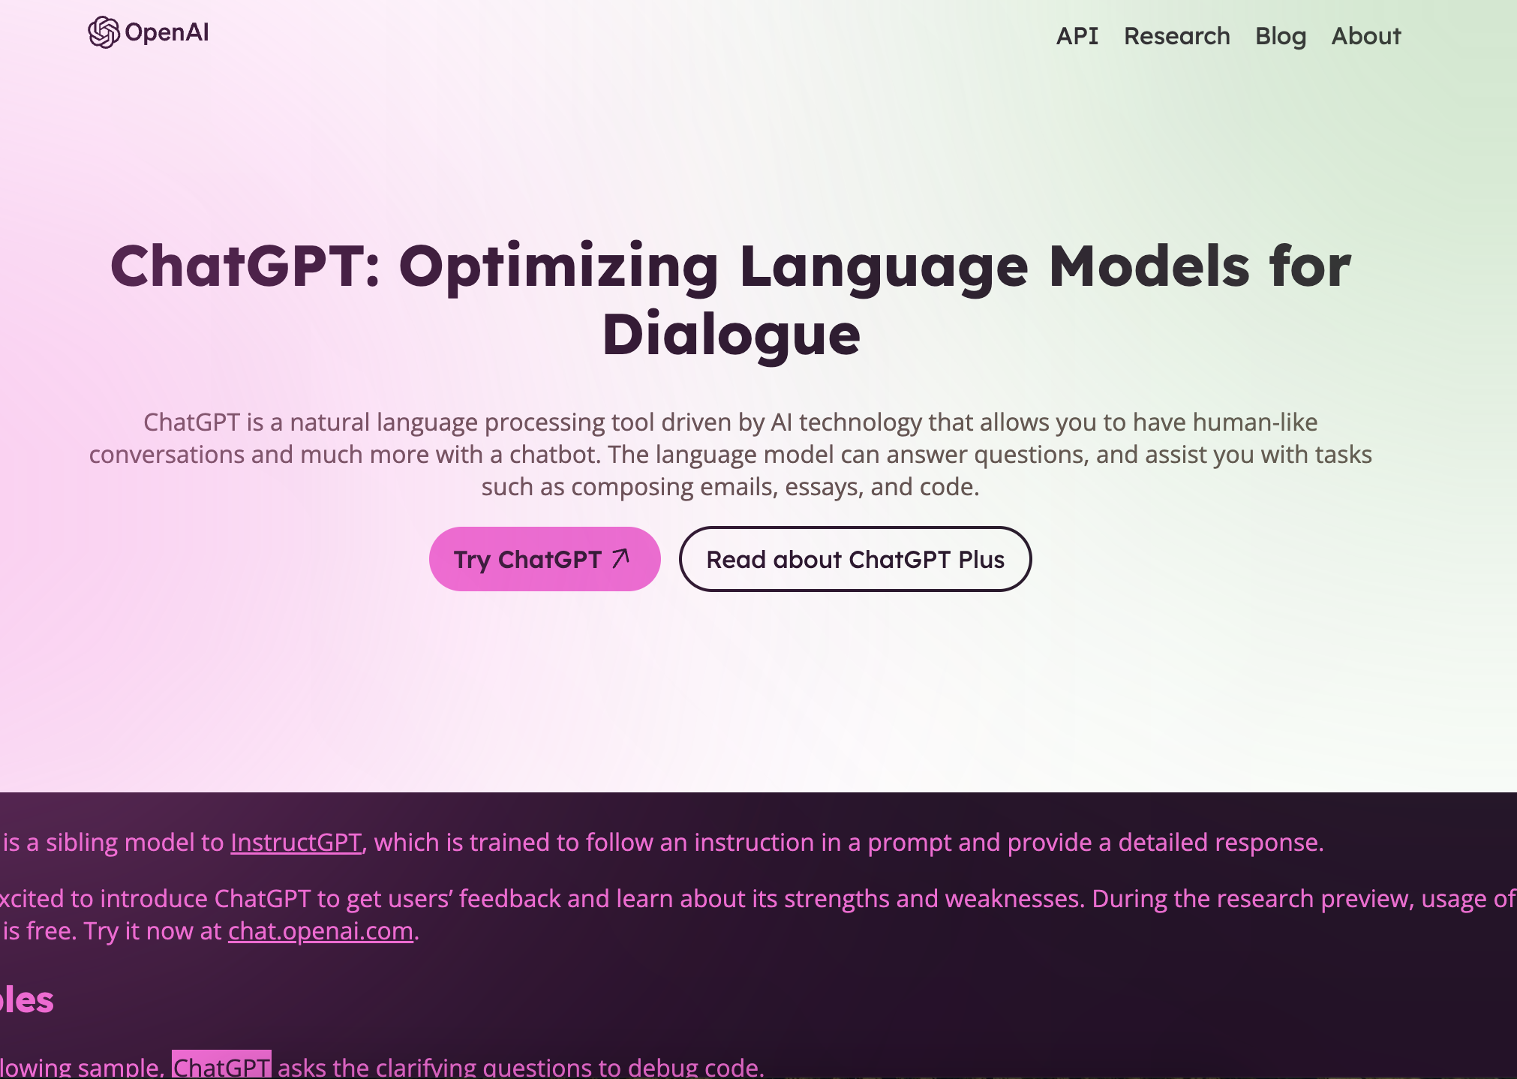
Introduction - Generative AI
Generative AI - ChatGPT
https://openai.com/index/chatgpt/
https://openai.com/index/introducing-4o-image-generation/

Slide 6
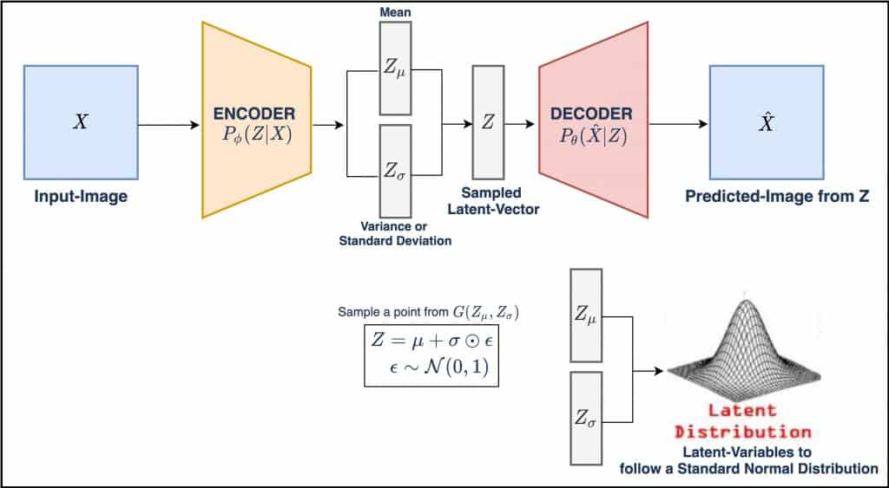
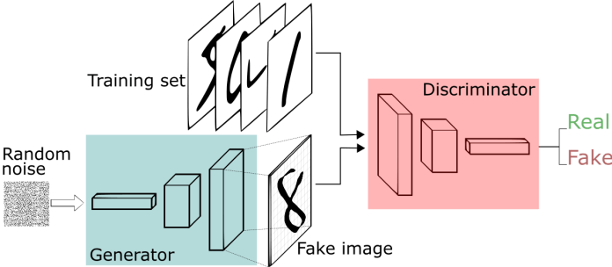
Introduction - Generated AI differs from traditional AI
Different Models
I. Goodfellow, J. Pouget-Abadie, M. Mirza, B. Xu, D. Warde-Farley, S. Ozair, A. Courville, and Y. Bengio, “Generative adversarial networks,” Communications of the ACM, vol. 63, no. 11, pp. 139–144, 2020.
L. Pinheiro Cinelli, M. Ara´ujo Marins, E. A. Barros da Silva, and S. Lima Netto, “Variational autoencoder,” in Variational methods for machine learning with applications to deep networks. Springer, 2021, pp. 111–149.

Slide 7
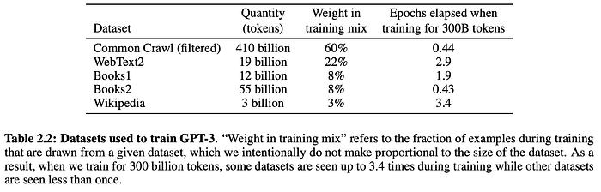
Introduction - Generated AI differs from traditional AI
Different Dataset Requirements
T. Brown, B. Mann, N. Ryder, M. Subbiah, J. D. Kaplan, P. Dhariwal, A. Neelakantan, P. Shyam, G. Sastry, A. Askell et al., “Language models are few-shot learners,” Advances in neural information processing systems, vol. 33, pp. 1877–1901, 2020

Slide 8
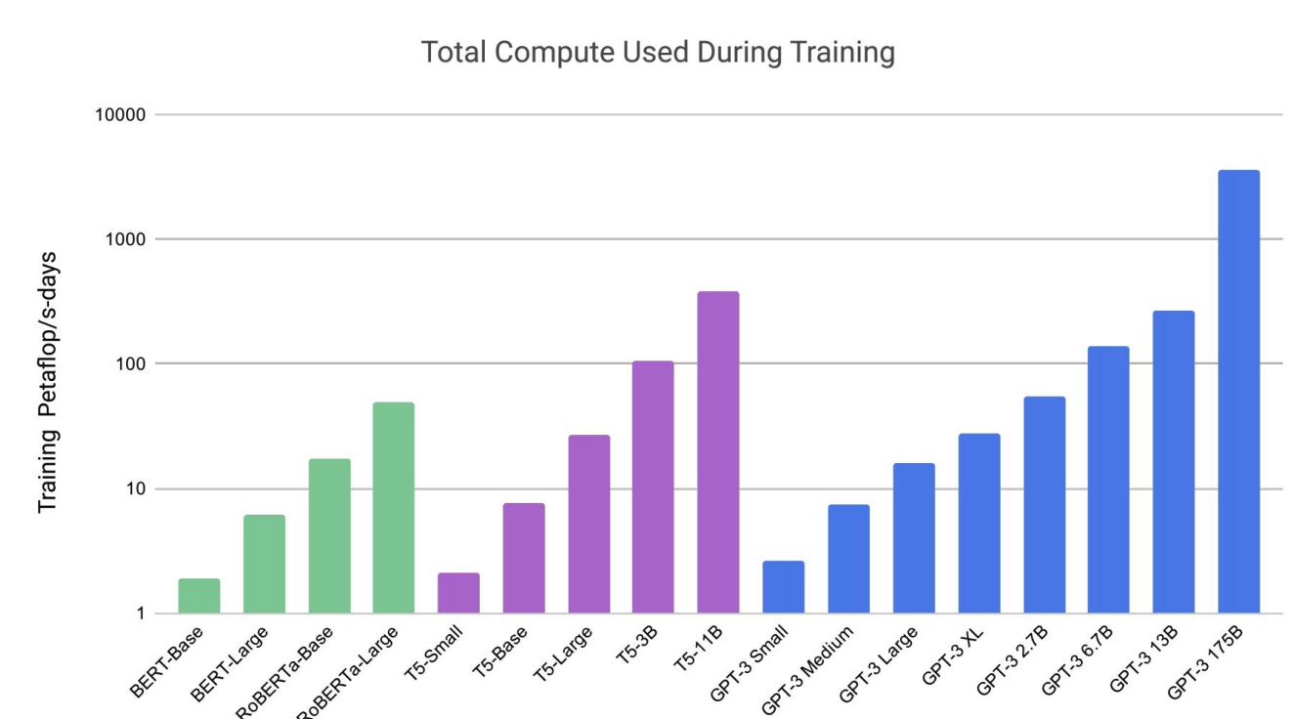
Introduction - Generated AI differs from traditional AI
Different Computing Resource Requirements
T. Brown, B. Mann, N. Ryder, M. Subbiah, J. D. Kaplan, P. Dhariwal, A. Neelakantan, P. Shyam, G. Sastry, A. Askell et al., “Language models are few-shot learners,” Advances in neural information processing systems, vol. 33, pp. 1877–1901, 2020

Slide 9
Introduction – Motivation for Generative AI with FL
Traditional ML
FL
Data Privacy and Security
Centralized data storage
FL train models locally
Lower communication overhead
Data is uploaded to server
FL train models locally
Enabling Real-time Updates
Models needs to be retrained for new scenarios
Directly update local model
Enhancing Model Generalization
Centralized data lead to bias
Provide customized local model updates

Slide 10
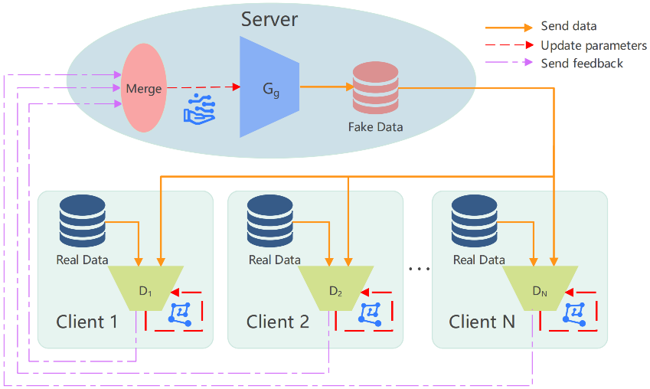
Federated GAN
The Loose Coupling Model of Federated GANs
J. Zhang, L. Zhao, K. Yu, G. Min, A. Y. Al-Dubai, and A. Y. Zomaya, “A novel federated learning scheme for generative adversarial networks,” IEEE Transactions on Mobile Computing, vol. 23, no. 5, pp. 3633–3649, 2023.

Slide 11
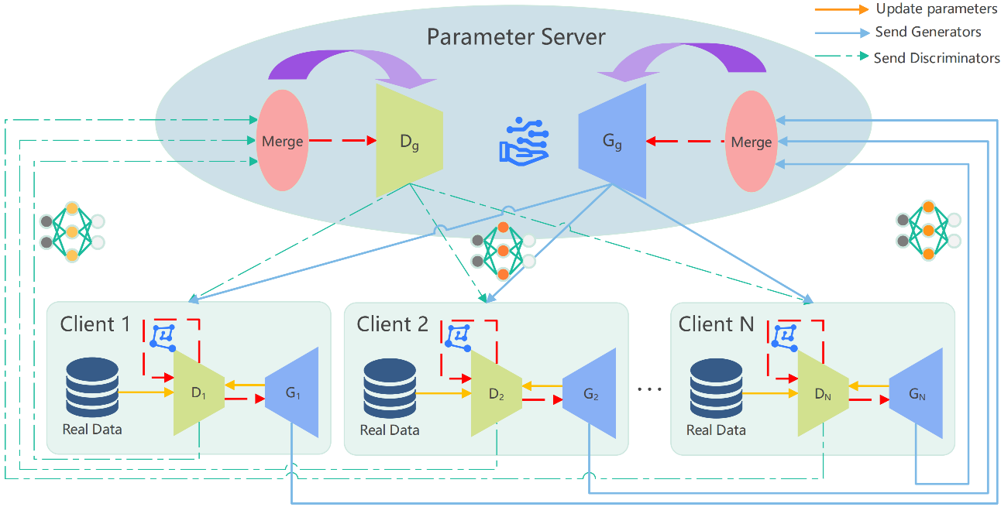
Federated GAN
The Tight Coupling Model of Federated GANs
B. Xin, W. Yang, Y. Geng, S. Chen, S. Wang, and L. Huang, “Private fl-gan: Differential privacy synthetic data generation based on federated learning,” in Icassp 2020-2020 IEEE international conference on acoustics,
speech and signal processing (ICASSP). IEEE, 2020, pp. 2927–2931.

Slide 12
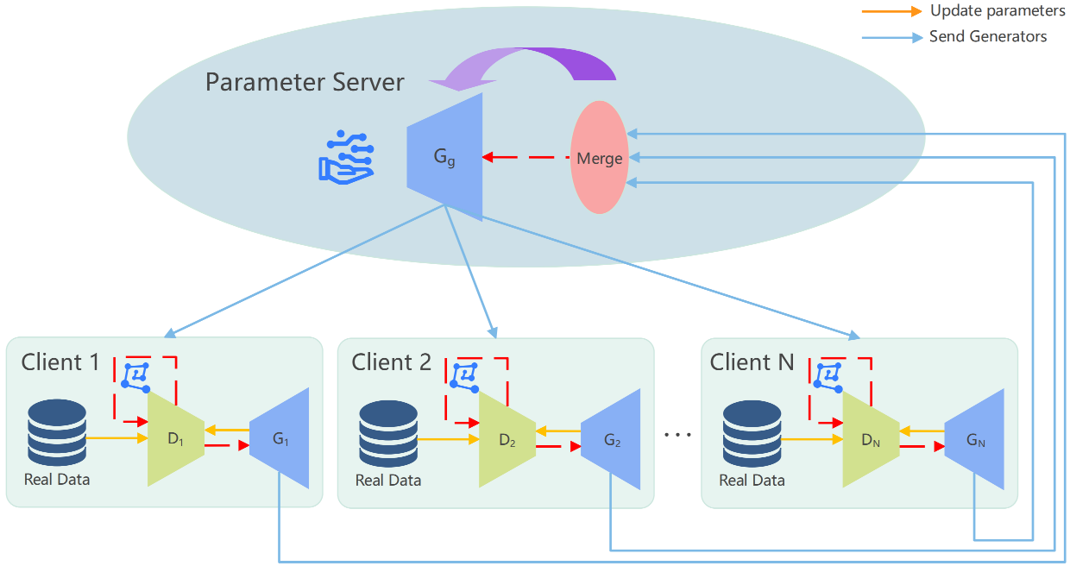
Federated GAN
The Flexible Coupling Model of Federated GANs
Q. Wu, X. Chen, Z. Zhou, and J. Zhang, “Fedhome: Cloud-edge based personalized federated learning for in-home health monitoring,” IEEE Transactions on Mobile Computing, vol. 21, no. 8, pp. 2818–2832, 2020.

Slide 13
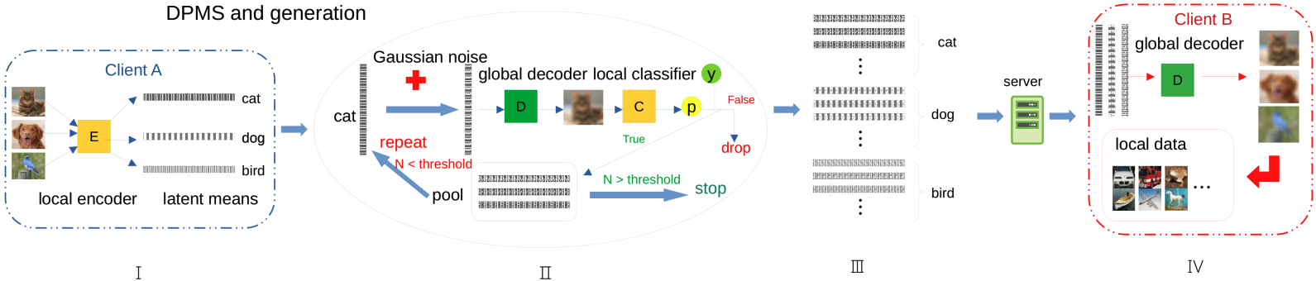
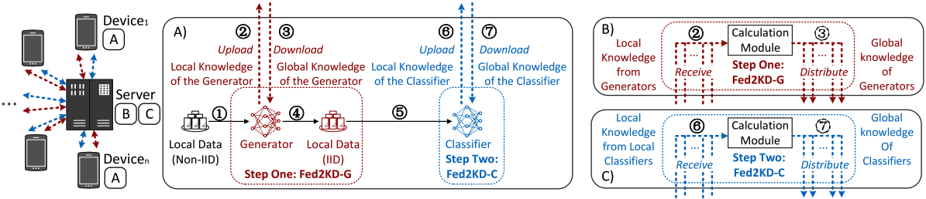
Federated VAE – synthetic data generation
FL in Non-IID Settings and synthetic data generation
H. Chen and H. Vikalo, “Federated learning in non-iid settings aided by differentially private synthetic data,” in Proceedings of the IEEE/CVF Conference on Computer Vision and Pattern Recognition, 2023, pp. 5027–503
H. Yang, M. Ge, K. Xiang, X. Bai, and H. Li, “Fedvae: Communication-efficient federated learning with non-iid private data,” IEEE Systems Journal, vol. 17, no. 3, pp. 4798–4808, 2023.
J.-h. Duan, W. Li, D. Zou, R. Li, and S. Lu, “Federated learning with data-agnostic distribution fusion,” in Proceedings of the IEEE/CVF Conference on Computer Vision and Pattern Recognition, 2023, pp. 8074–808

Slide 14
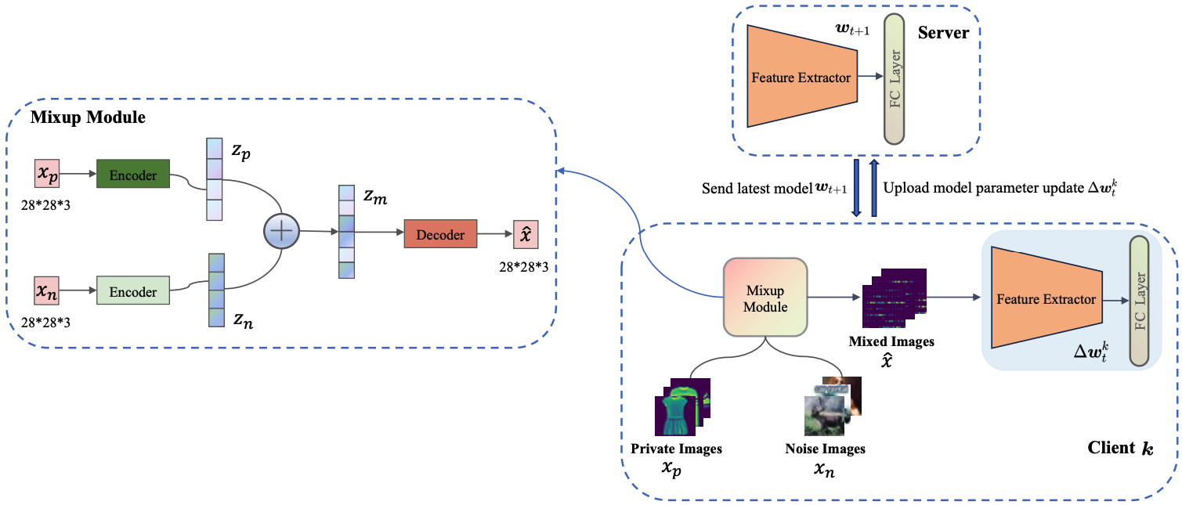
Federated VAE – gradient inversion attack
J. Liu, X. Luo, Z. Zhao, Z. Chang, M. Pan, P. Li, G. Min, and H. Li,“Fed2vaes: An efficient privacy-preserving federated learning approach based on variational autoencoders,” in ICC 2024-IEEE International Conference on Communications. IEEE, 2024, pp. 2634–263
W. Issa, N. Moustafa, B. Turnbull, and K.-K. R. Choo, “Rve-pfl: Robust variational encoder-based personalised federated learning against model inversion attacks,” IEEE Transactions on Information Forensics and Security, 2024

Slide 15
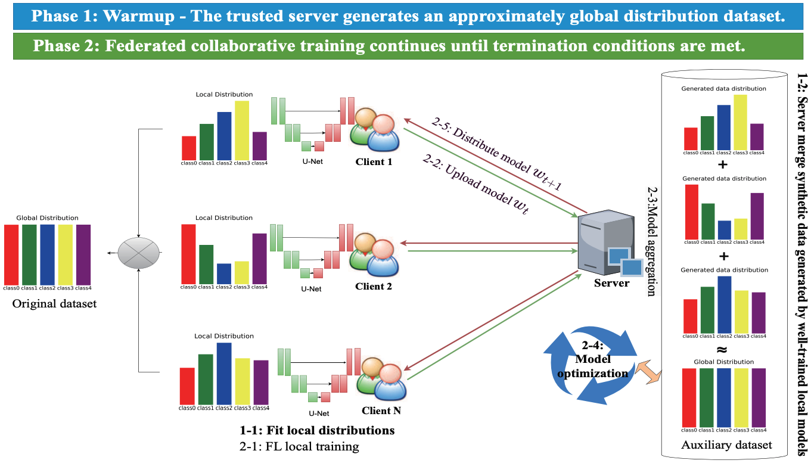
Federated Diffusion Model
FL in Non-IID Settings and synthetic data generation
Z. Peng, X. Wang, S. Chen, H. Rao, C. Shen, and J. Jiang, “Federated learning for diffusion models,” IEEE Transactions on Cognitive Communications and Networking, 2025.
Z. Zhao, F. Yang, and G. Liang, “Federated learning based on diffusion model to cope with non-iid data,” in Chinese Conference on Pattern Recognition and Computer Vision (PRCV). Springer, 2023, pp. 220–231.

Slide 16
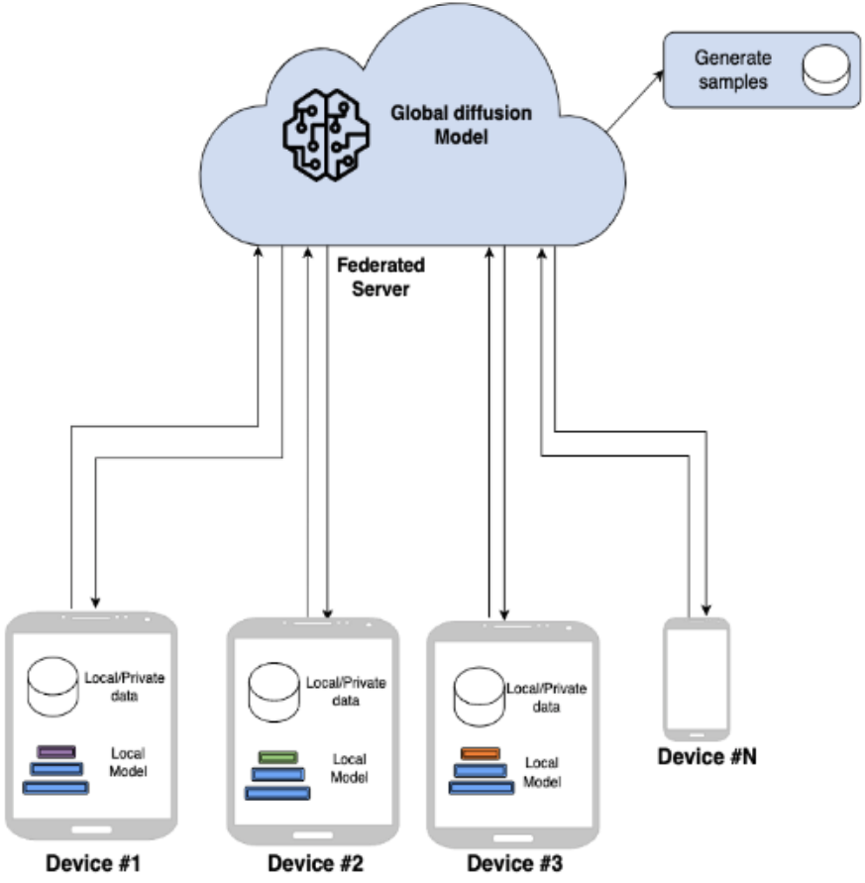
Federated Diffusion Model
FL in Non-IID Settings and Decoupling model
F. V. Stanley Jothiraj and A. Mashhadi, “Phoenix: A federated generative diffusion model,” in Companion Proceedings of the ACM Web Conference 2024, 2024, pp. 1568–1577.
Di, H. Shi, X. Wang, R. Ma, and Y. Liu, “Federated recommender system based on diffusion augmentation and guided denoising,” ACM Transactions on Information Systems, vol. 43, no. 2, pp. 1–36, 2025.

Slide 17
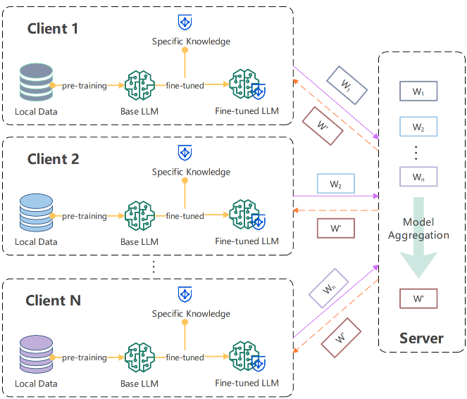
Federated Transformer
Y. Tan, G. Long, J. Ma, L. Liu, T. Zhou, and J. Jiang, “Federated learning from pre-trained models: A contrastive learning approach,” Advances in neural information processing systems, vol. 35, pp. 19 332–19 344, 2022.
H. Chen, Y. Zhang, D. Krompass, J. Gu, and V. Tresp, “Feddat: An approach for foundation model finetuning in multi-modal heterogeneous federated learning,” in Proceedings of the AAAI Conference on Artificial
Intelligence, vol. 38, no. 10, 2024, pp. 11 285–11 293.

Slide 18
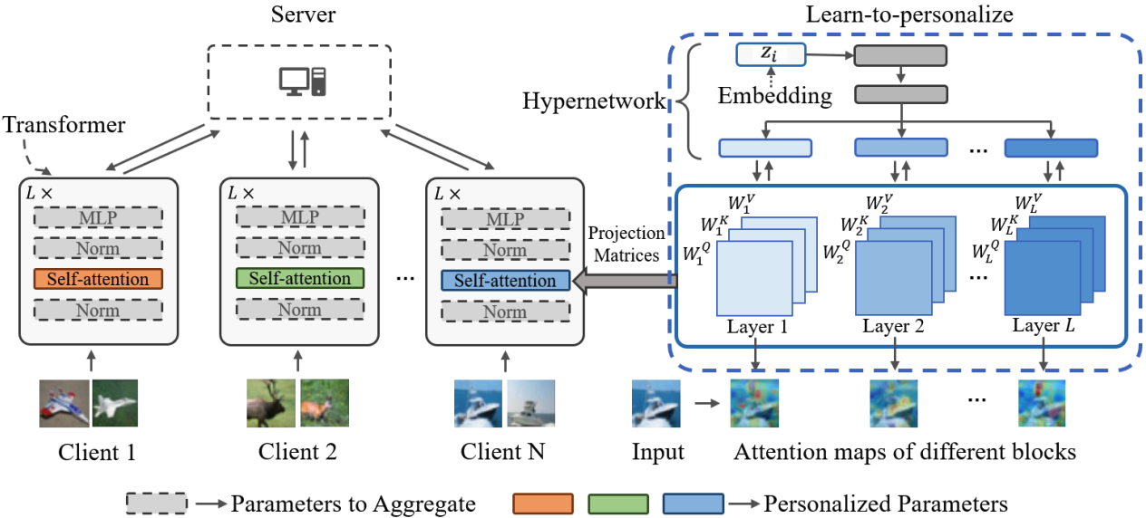
Federated Transformer
FL in Non-IID Settings and Transformer Personalization
H. Li, Z. Cai, J. Wang, J. Tang, W. Ding, C.-T. Lin, and Y. Shi, “Fedtp: Federated learning by transformer personalization,” IEEE transactions on neural networks and learning systems, 2023

Slide 19
Summary
Diverse content generation
FL for Generated AI
Privacy preservation
FL for Generated AI
Synthetic data generation
Generated AI for FL

Slide 20
Thank You!

Slide 21
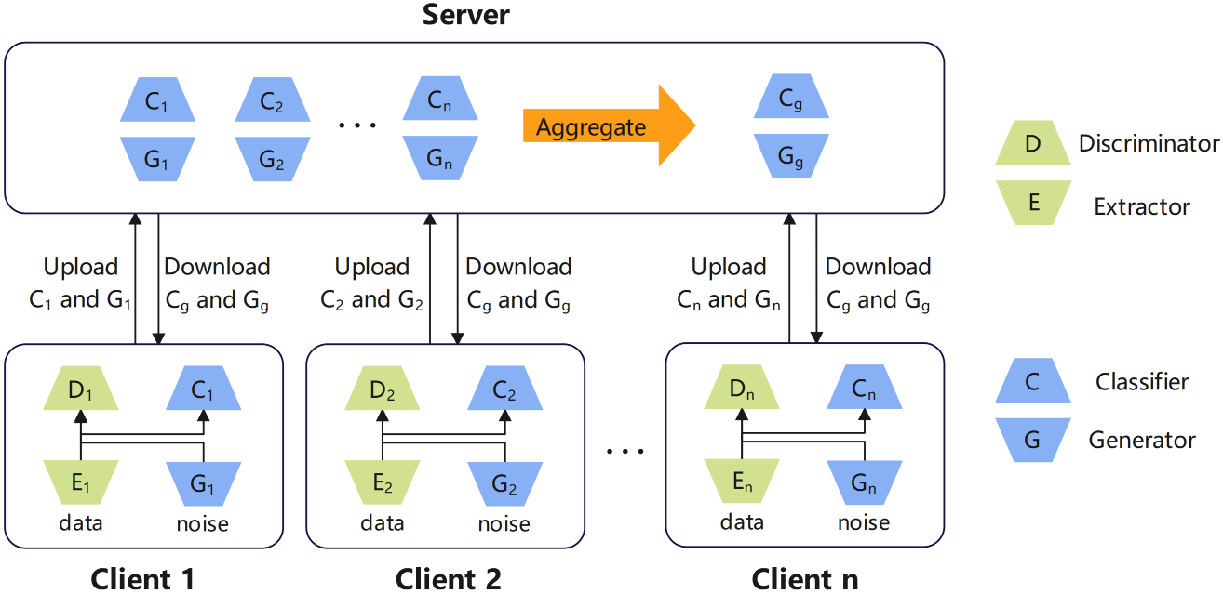
Federated GAN
the FedCG program
Y. Wu, Y. Kang, J. Luo, Y. He, and Q. Yang, “Fedcg: Leverage conditional gan for protecting privacy and maintaining competitive performance in federated learning,” arXiv preprint arXiv:2111.08211, 2021.

